Slide 1
Windows 7 vs Windows 10
By: Parsa Ahmadi Nasab Emran
CIS1055 Section 005

Slide 2
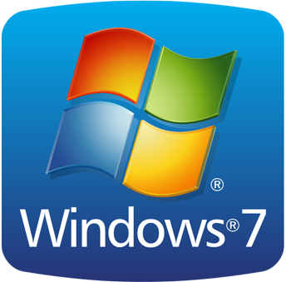
What is Windows 7?
Windows 7 (codenamed Vienna, formerly Blackcomb) is a personal computer operating system developed by Microsoft.
It is a part of the Windows NT family of operating systems.

Slide 3
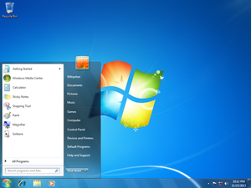
Features of Windows 7
Start Menu – The Start Menu provides the primary access point for programs and applications on your ThinkPad.
Taskbar and Notification Area – The Taskbar contains 3 main components, the Start button, the Task/Quick launch bar and the System Notification Area.
Windows Snipping Tool – Windows 7 includes an application to capture, save and share “snipped” images from your desktop.
Displaying to a External Monitor or Projector – The ThinkPad is equipped with one or more external display connectors so that you may connect to an external monitor or the multimedia projector.
Using Local Area Networks – The ThinkPad is configured to access both wired and wireless network resources.
Windows Explorer Favorites – File system favorites are quick links to specific directories (folders) located on your hard drive.
Windows Explorer Libraries – Libraries are an easy way to collect and track documents on your computer that are related to one another but are not necessarily located in the same directories (folders).

Slide 4
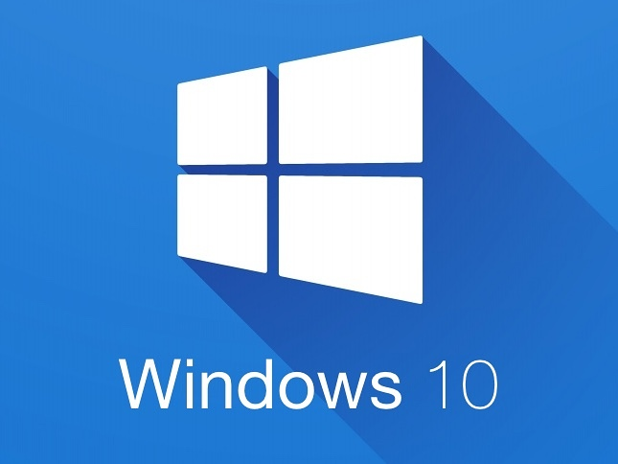
What is Windows 10?
Windows 10 is the latest release of Microsoft's Windows operating system and the successor to the underwhelming Windows 8 (and Windows 8.1).

Slide 5
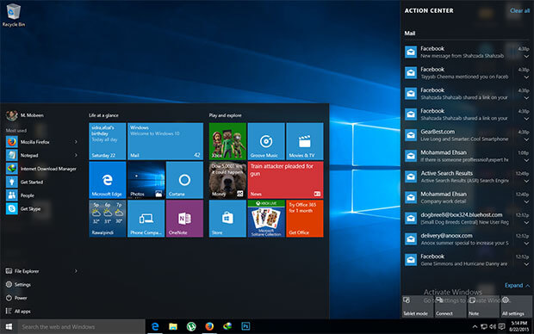
Features of Windows 10
The Start Menu
Cortana
Microsoft Edge replaces Internet Explorer
You can add multiple desktops
Central Notification Center
Universal Apps and Continuum Bridge Tablets and PCs

Slide 6
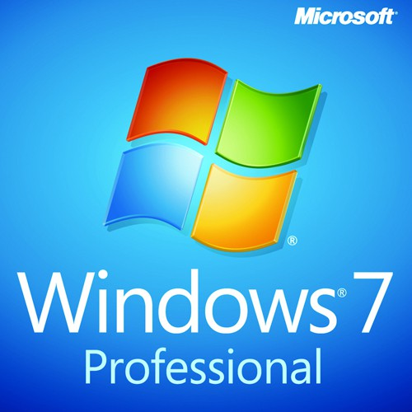
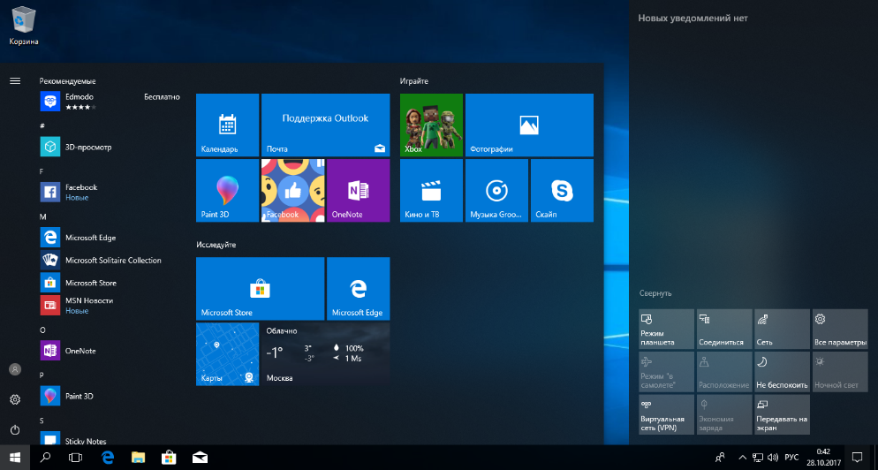
Difference Between Windows 7 and Windows 10
Windows 7
Windows 10
Windows 7 is only supported on PCs and laptops.
Windows 10 is an attempt to synchronize the OS on all its products. This includes PCs, laptops, tablets, phones, as well as its Xboxes.

